Slide 1

Game overview presentation
Muhammad ali Haidar, Imad Masood, Dana Naidas,
Samara Sarmiento
Samara Sarmiento

Slide 2
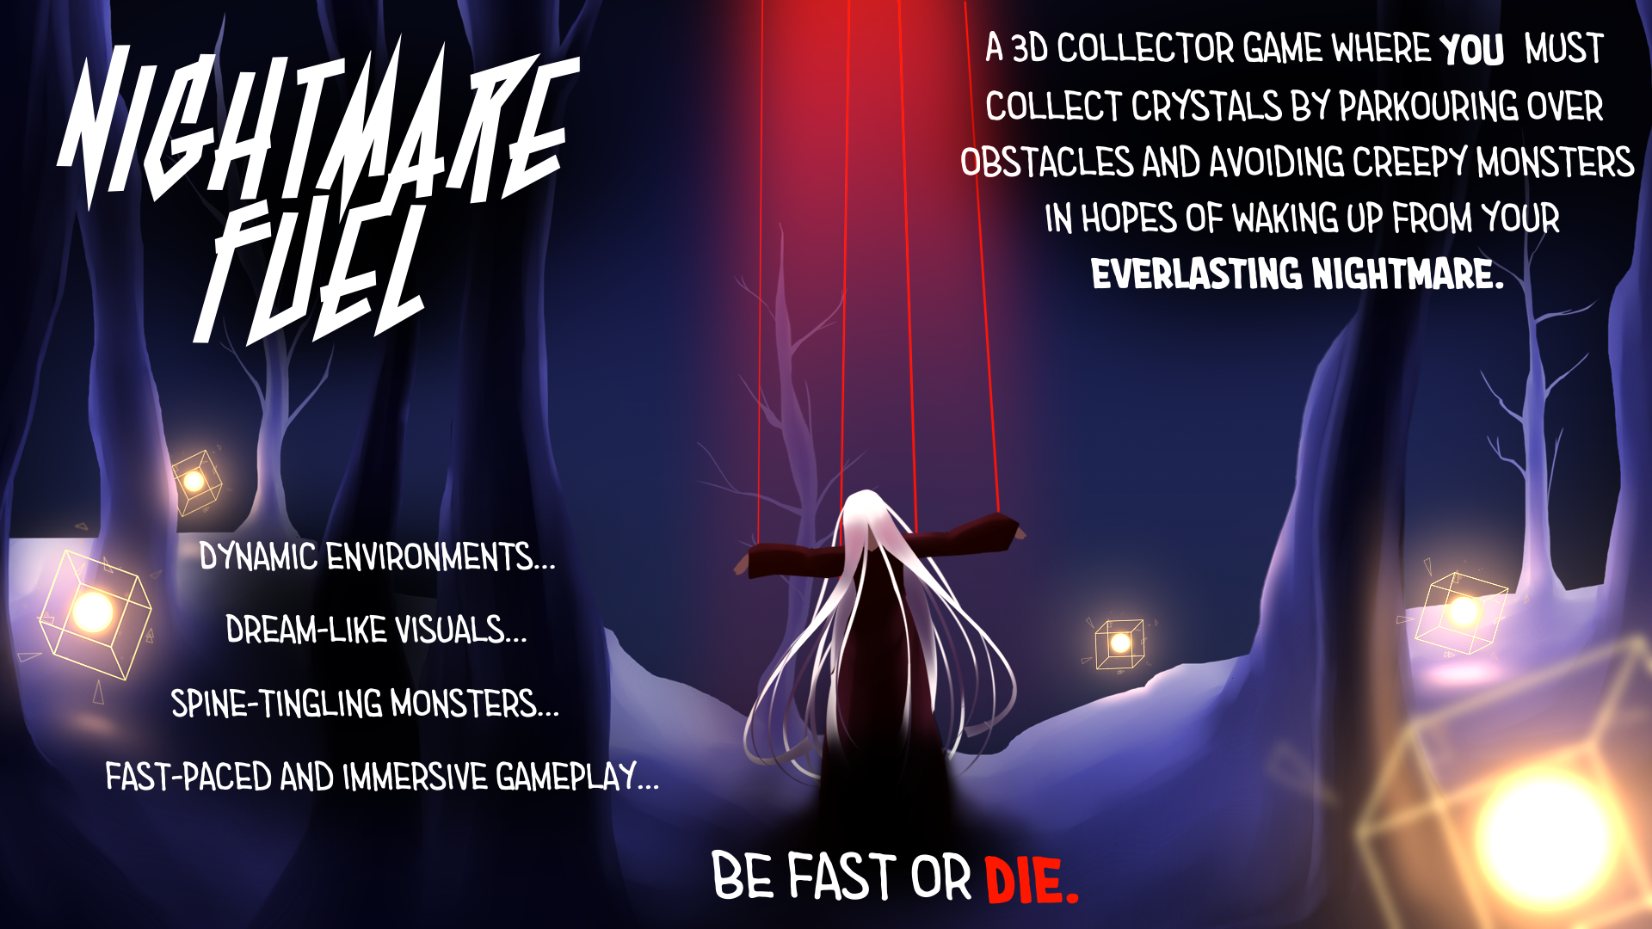

Slide 3
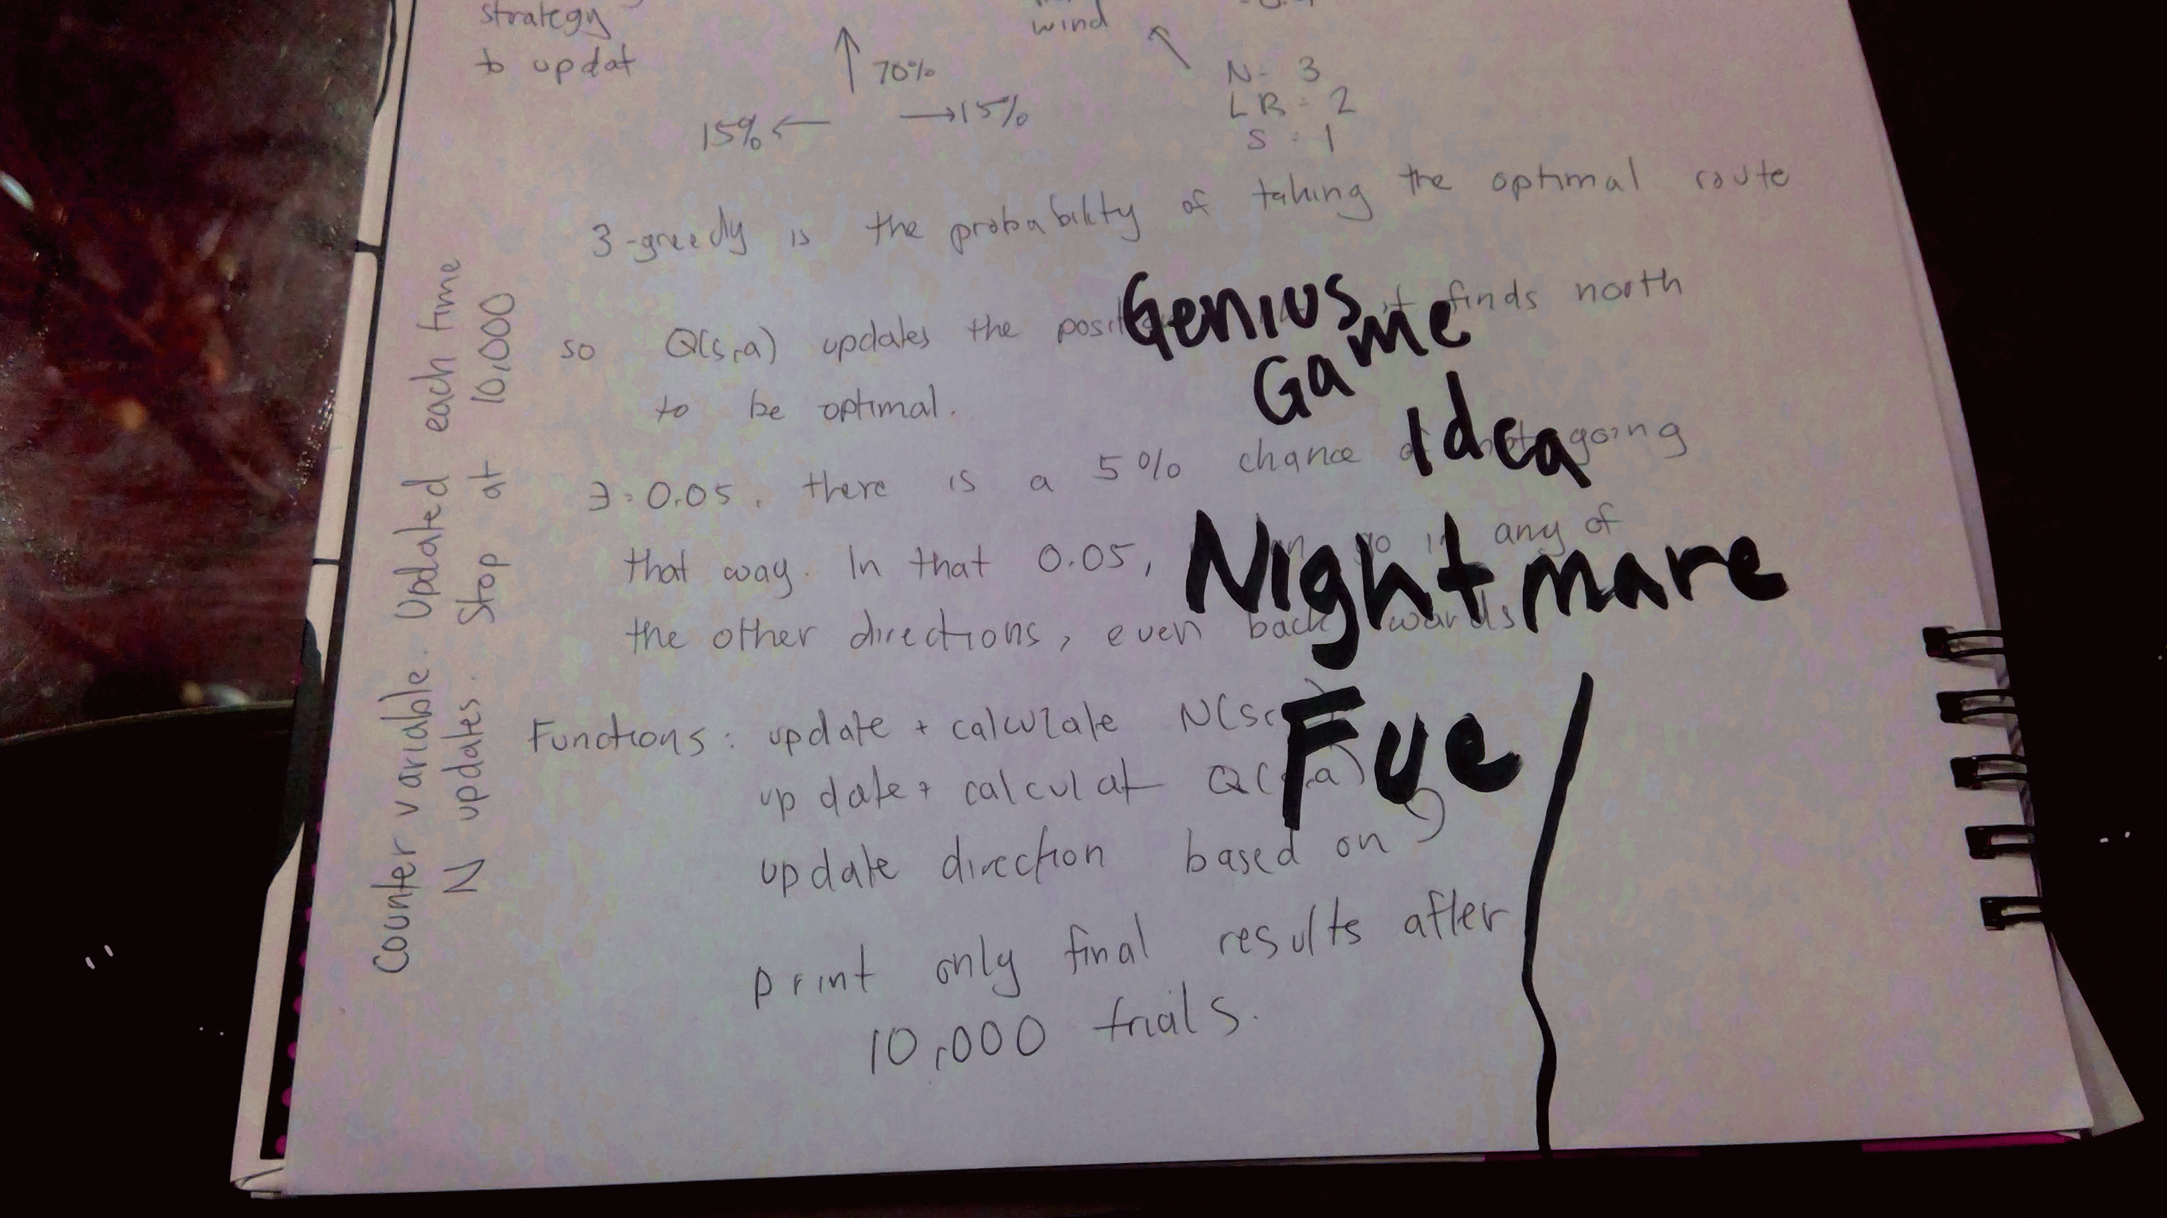
Game pitch: Intro

Slide 4
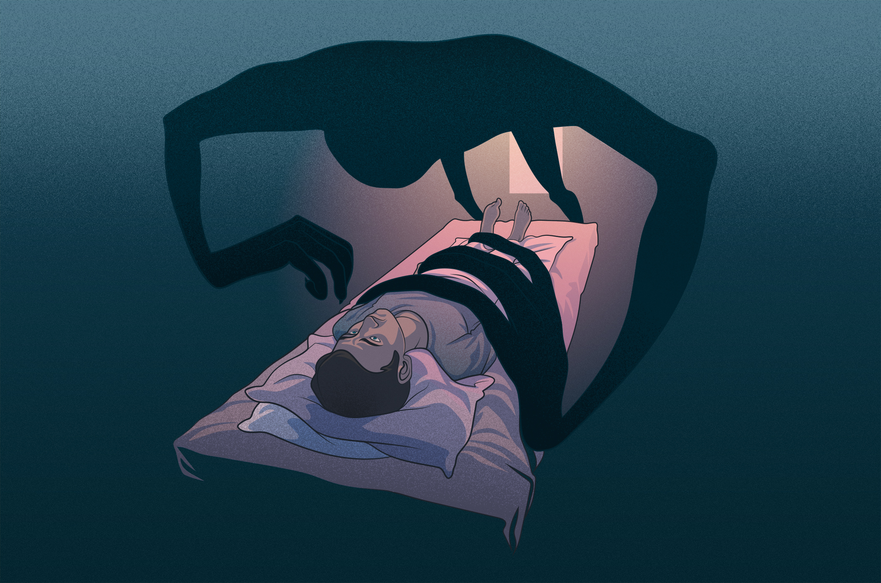
Game pitch: pitch
Noah Nem
Insomnia
Aid Noah Nem
Collect Crystals

Slide 5
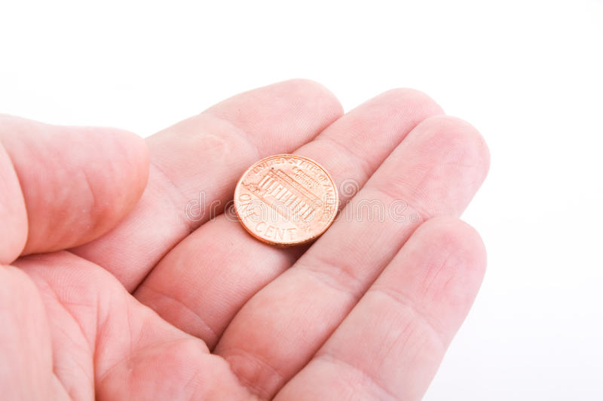

Game pitch: Funding

Slide 6


For the beta
Current Models:
Beta

